Slide 1

Advanced Image Retrieval Using CIFAR-10 Dataset
.

Slide 2

Presented By:
Team 7:
Anjana Vollala
Sukeerthi Sri Sai Kunapareddy
Sai Krishna Rudraraju
Sai Maanasa Rikkala

Slide 3

Introduction
Image retrieval involves searching and retrieving images from a large database that are similar to a given query image
This project focuses on developing an advanced image retrieval system using the CIFAR-10 dataset, which is a standard benchmark in image classification and retrieval tasks.
The primary goal is to build a system that can efficiently and accurately retrieve similar images based on their visual features.
This involves several steps: data preprocessing and augmentation, feature extraction using a deep learning model, dimensionality reduction, feature normalization, and implementing an efficient similarity search mechanism using FAISS (Facebook AI Similarity Search)

Slide 4

Project Goals:
Data preprocessing and augmentation.
Feature extraction using deep learning.
Dimensionality reduction.
Feature normalization.
Implementing similarity search with FAISS
Workflow Summary:
Load and prepare data.
Augment data to improve model robustness.
Extract features using a pre-trained model.
Reduce feature dimensions with PCA.
Normalize features for similarity measurement.
Build and use FAISS for fast image retrieval.

Slide 5

CiFar-10 Dataset Overview
CIFAR-10 is a popular image dataset used in the field of computer vision and machine learning. It was created by the Canadian Institute For Advanced Research (CIFAR) and collected by Alex Krizhevsky, Vinod Nair, and Geoffrey Hinton. CIFAR-10 is often used for benchmarking image classification algorithms because of its diverse set of images and well-structured categories.
Dataset Size: 60,000 images in total.
Training Set: 50,000 images
Test Set: 10,000 images
Image Characteristics:
Image Size: 32x32 pixels
Color: RGB (3 color channels)
File Format: Images are stored in binary format for the dataset files; individual images can be exported as PNG/JPEG for visualization.

Slide 6
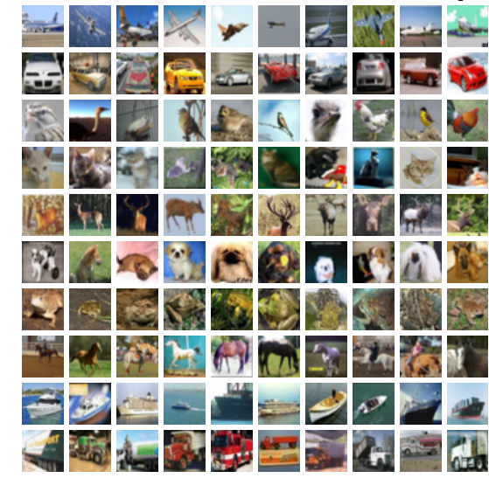
Overview
Classes:
The dataset contains 10 classes, with 6,000 images per class.
Classes include:
Airplane
Automobile
Bird
Cat
Deer
Dog
Frog
Horse
Ship
Truck

Slide 7
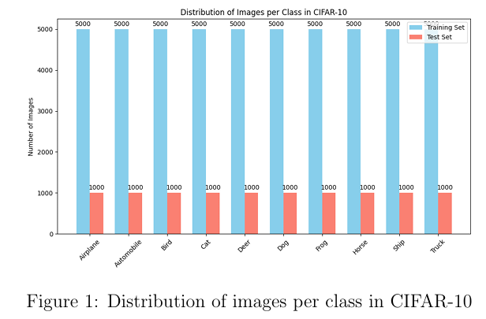
Data Distribution
Data Distribution As shown in Figure 1, each class has an equal number of images, ensuring a balanced dataset for training and evaluation.

Slide 8

Method
Data Augmentation: Includes:
1. Rotation
2. Width and Height shifts
3. Horizontal Flip
Feature Extraction
Dimensionality Reduction
Feature Normalization
Similarity search with FAISS
Evaluation Metrics:
1. Mean Precision@5
2. Mean Recall
3. Mean Average Precision

Slide 9
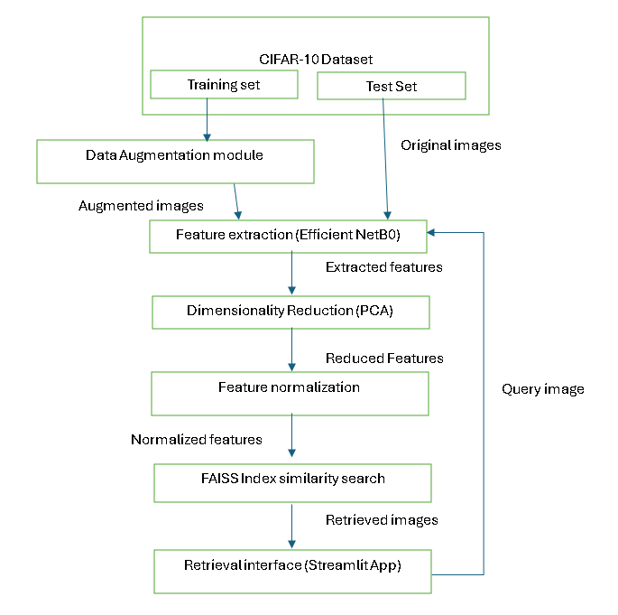
Architecture:

Slide 10
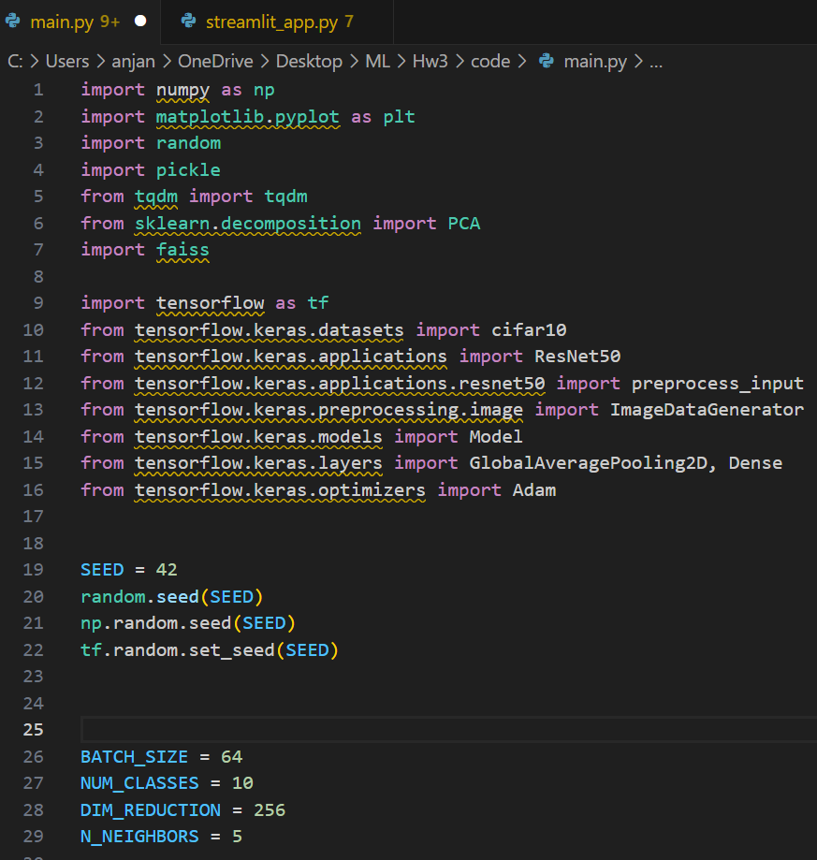
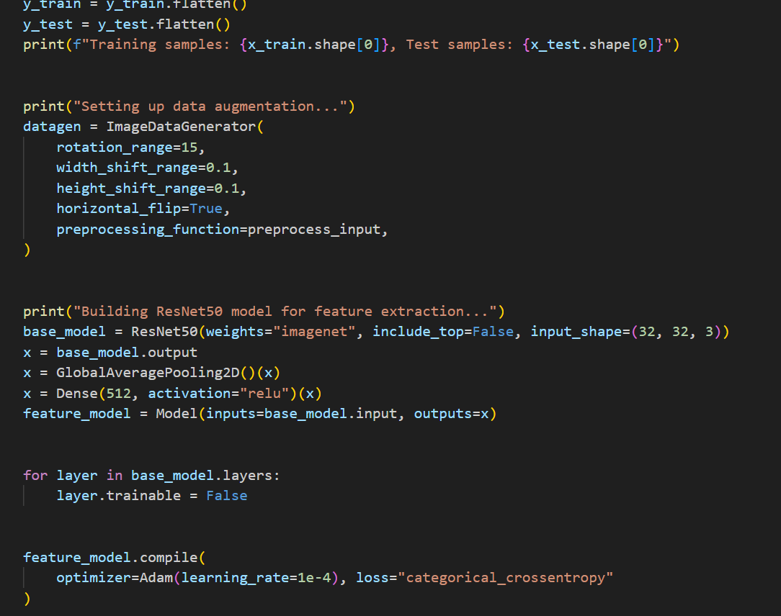
Code snippets:

Slide 11
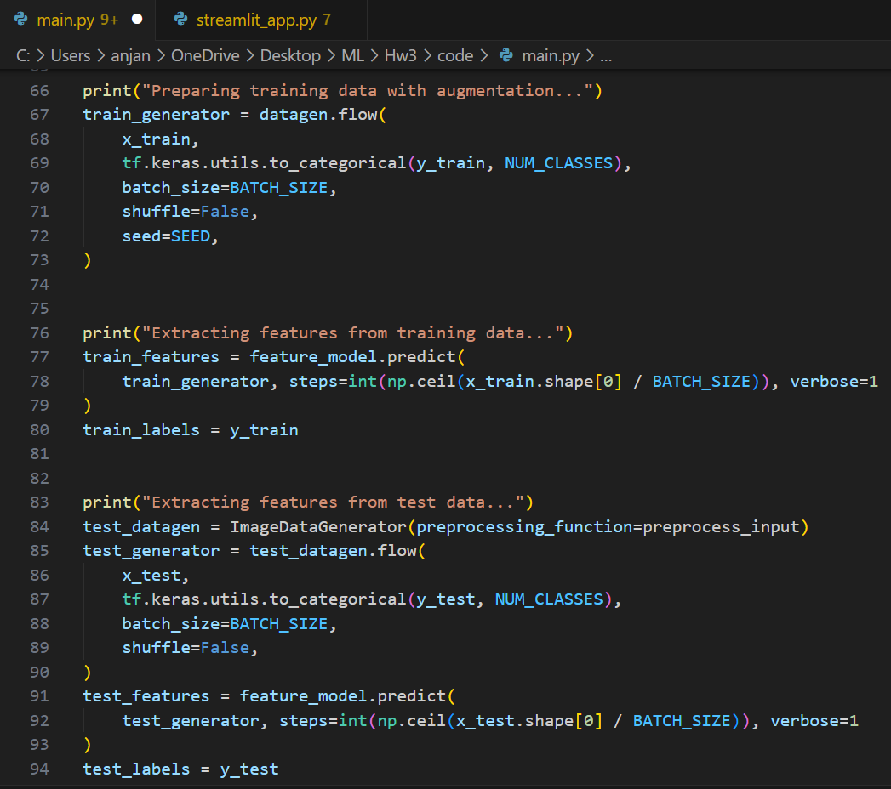
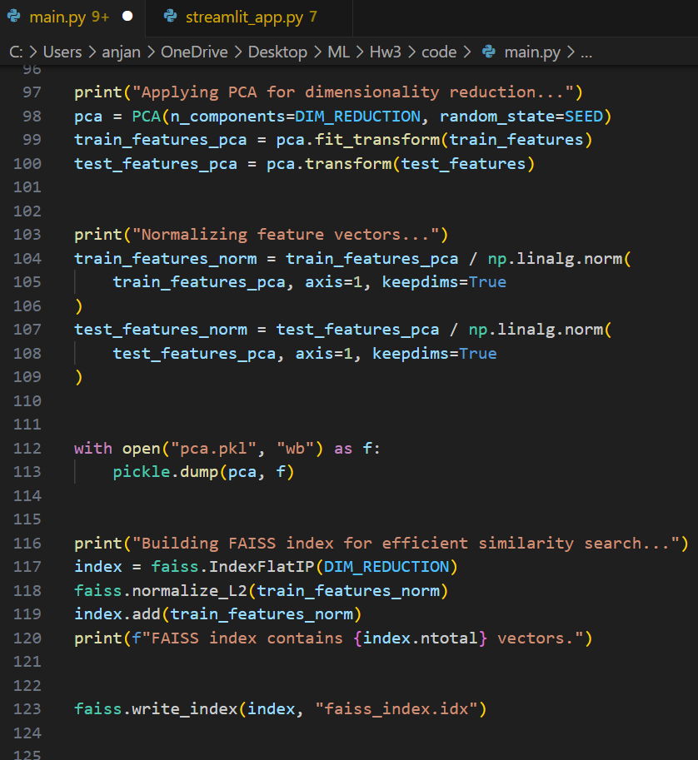
Code:

Slide 12
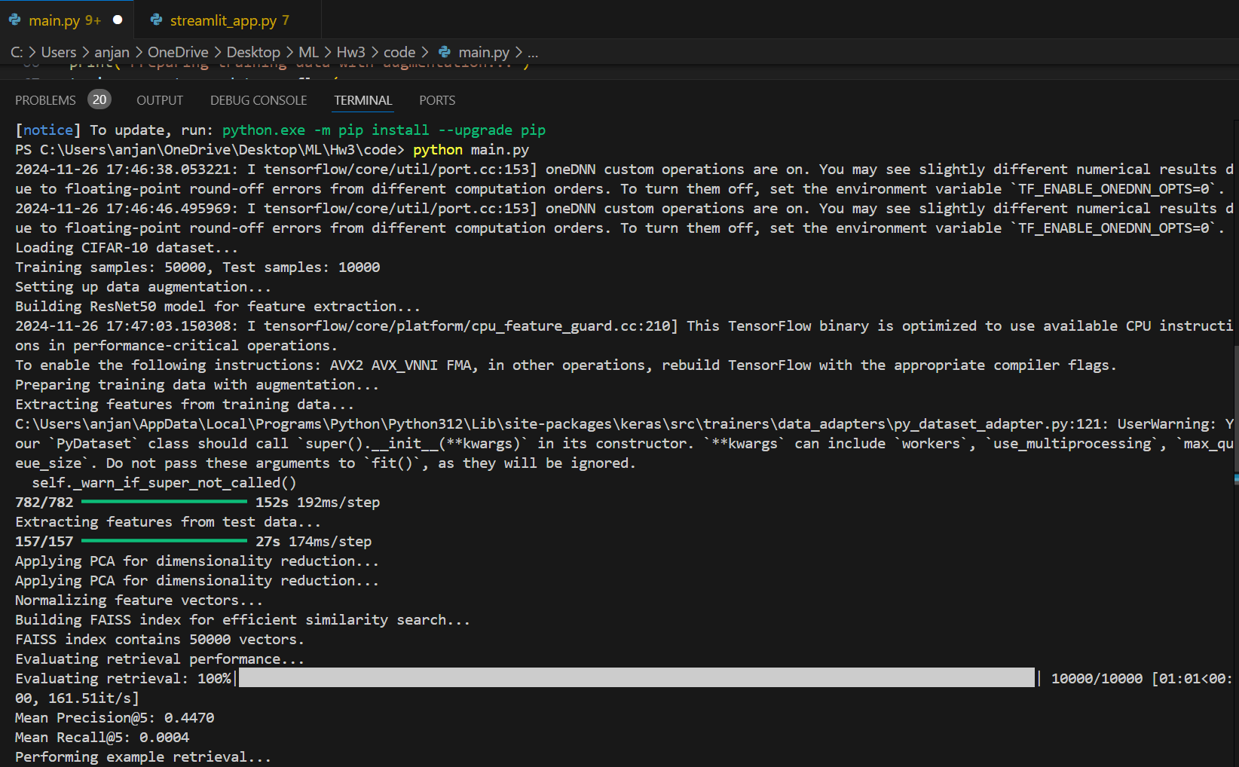
Output:

Slide 13
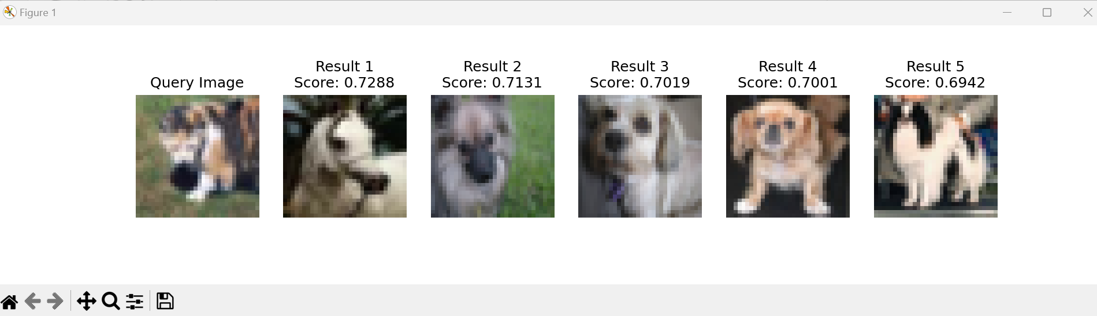
Output:

Slide 14
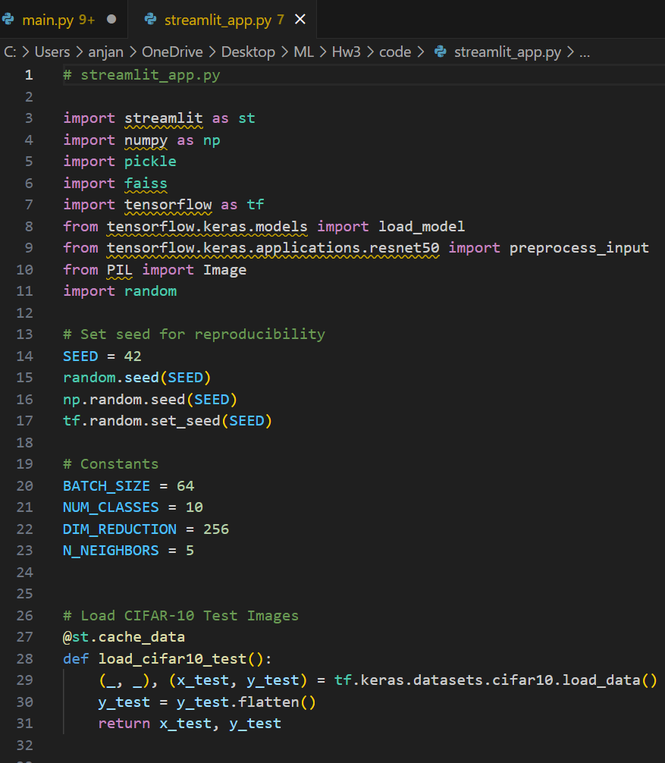
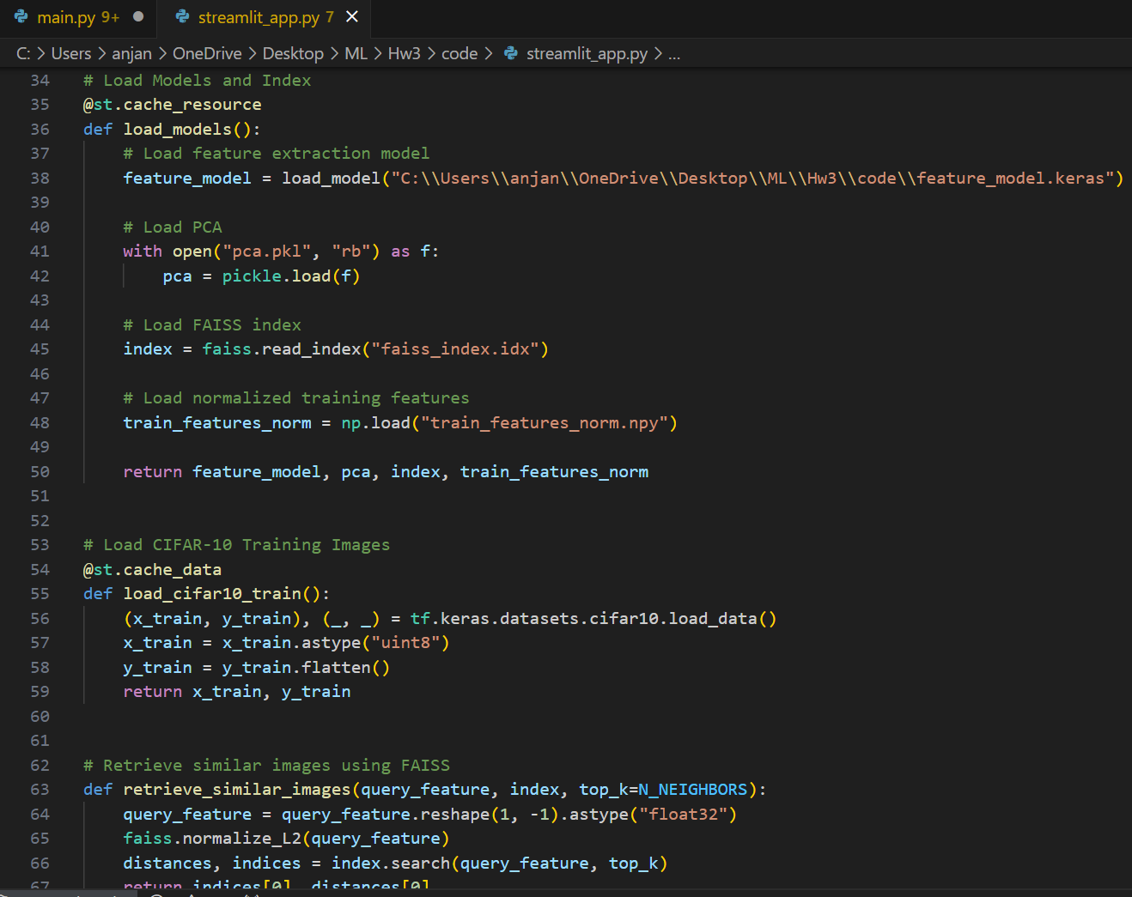
Added Feature:

Slide 15
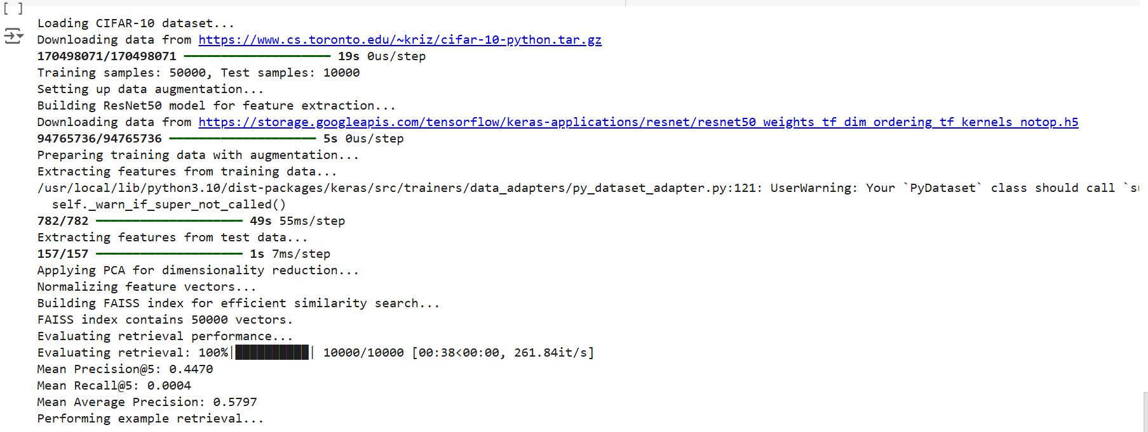
Result:

Slide 16
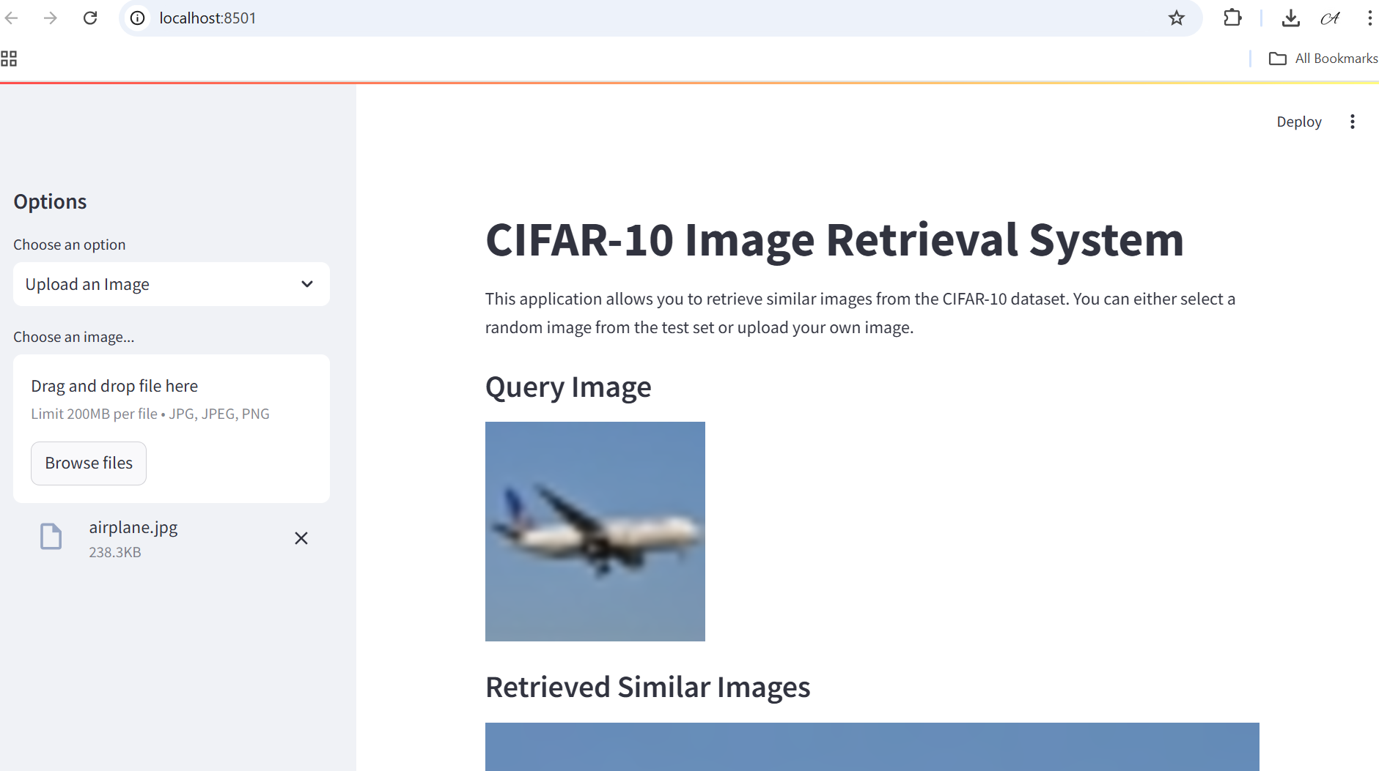
Results:

Slide 17
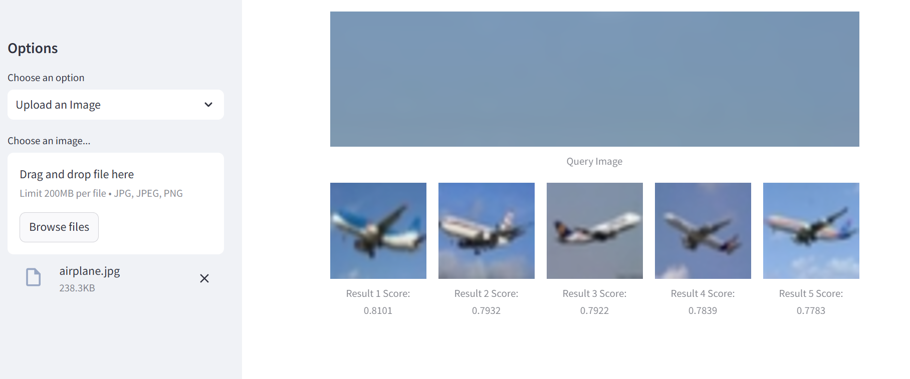
Results:

Slide 18

Challenges
Low Resolution: The small 32x32 size can make it challenging for detailed object recognition.
Interclass Similarity: Some classes (e.g., cat vs. dog, automobile vs. truck) have visually similar features, leading to misclassifications.
Limited Context: Objects are shown without much background, reducing useful contextual information.
Intraclass Variability: Large differences within each class (e.g., different dog breeds) make generalization challenging.

Slide 19
Advantages
Improved Search Accuracy
Efficient Feature Representation
Enhanced User Experience in Applications
Learning from Diverse Object Categories
Benchmark for Evaluating Retrieval Algorithms
Multi-Modal Search

Slide 20
Conclusion:
Project Achievements:
Developed a functional image retrieval system using CIFAR-10.
Achieved good precision and overall performance.
Key Takeaways:
Effective feature extraction and efficient indexing are crucial.
Data augmentation enhances model robustness.
Future Call:
Improve recall and retrieval accuracy.
Fine-tune models and explore advanced techniques for better performance.

Slide 21

Q & A ?

